Slide 1


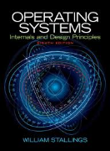
Welcome to
CS 345 Operating Systems
Chapter 1 (03)

Slide 2

Chapter 1 – Computer Systems
Part 1

Slide 3
1.2 Malloc/free argc/argv
All tasks functions (main’s) are passed two arguments:
The first (conventionally called argc, for argument count) is the number of command-line arguments (including the program name).
The second (argv, for argument vector) is a pointer to an array of character pointers (strings) that contain the arguments, one per string.
By convention, argv[0] points to the program name and argv[argc] is a null pointer.
Modify the function P1_shellTask() (os345p1.c) to parse the commands and parameters from the keyboard inbuffer string into traditional argc and malloc'd argv C variables:
Your shell executes the command directly using a function pointer with malloc’d arguments, waits for the function to return, and then recovers memory (free) before prompting for the next command.
Commands and arguments are case insensitive.
Quoted strings are treated as one argument and case is preserved within the string.

Slide 4
1.2 Malloc/free argc/argv
inbuffer
echo Good "Morning America"\0
argv
echo\0
good\0
Malloc'd memory
Morning America\0
\0
argv = (char**)malloc(argc*sizeof(char*));
for each argument i
argv[i] = (char*)malloc(strlen(arg)+1);
strcpy(argv[i], arg);
int retValue = (*commands[?]->func)(argc, argv);
for each argument i free(argv[i]);
free(argv);

Slide 5
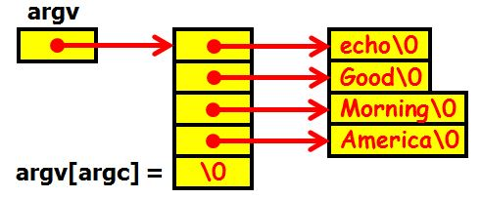
The main Function
What is the output of the following echo C program?
>>echo Good Morning America
Good
Morning
America
>>
int main(int argc, char* argv[ ])
{
while (--argc > 0)
{
printf("%s%s", *++argv, (argc > 1) ? " " : "");
}
printf("\n");
return 0;
}

Slide 6
1.3 Background Tasks
Implement background execution of programs:
If the command line ends with an ampersand (&), your shell creates a new task to execute the command line. (Otherwise, your shell calls the command function (and waits for the function to return.)
Use the createTask function to create a background process.
int createTask(char* name, // task name
int (*task)(int, char**), // task address
int priority, // task priority
int argc, // task arg count
char** argv) // task arg list
The command arguments are passed to the new task in malloc'd argv strings. Modify the function createTask (os345tasks.c) to malloc new argc and argv variables.
Modify the function sysKillTask (also in os345tasks.c) to recover malloc'd createTask memory.

Slide 7
1.3 Background Tasks
int createTask(char* name,
int (*task)(int, char**),
int priority,
int argc, char** argv)
{
// populate new TCB
// malloc new argv variables
// put task in ready queue
} // end creatTask
int P1_shellTask(int argc, char* argv[])
{
while (1)
{
SEM_WAIT(inBufferReady);
// parse command line into
// malloc’d argv variables
// execute command
if (background)
// call createTask
else // call function directly
// free malloc’d memory
while (argc) free(argv[argc--]);
free(argv);
}
} // end P1_shellTask
int sysKillTask(int taskId)
{
// delete task semaphores
// delete task from ready queue
// free task malloc’d variables
// release TCB
} // end sysKillTask

Slide 8
Chapter 1 – Computer Systems

Slide 9

Quiz: Define the following terms
Let's move to breakout rooms for 10-15 minutes to define the following terms in your chat box:
Kernel
Systems program
Applications program
Middleware
Firmware
Bootstrap program
Daemon
Device Driver
Asymmetric multiprocessing
Symmetric multiprocessing

Slide 10


Be Safe

